Slide 1
Econ 100 Principles of Economics
Lecture 16
April 3

Slide 2
Today: We start with macroeconomics.
A slightly depressing lecture

Slide 3
First a little bit of time traveling
Back to 1929, New York City

Slide 4
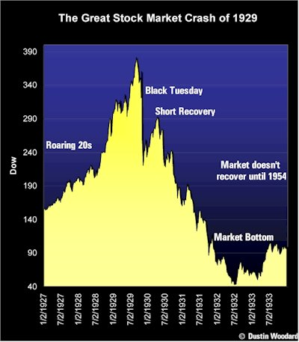
Black Tuesday. The stock market crash of 29 October 1929

Slide 5
A five-year bull market peaked on 3 September 1929.
On Thursday 24 October, a record 12.9 million shares were traded, reflecting panic selling.
On Monday 28 October, panicked investors continued to try to sell stocks; the Dow saw a record loss of 13%.
On Tuesday 29 October 1929, 16.4 million shares were traded, shattering Thursday's record; the Dow lost another 12%. Total losses for the four days: $30 billion. This is $378 billions in 2008 dollars, it is 10 times US federal budget and more than the U.S. had spent in World War I.

Slide 6
So what if the stock market crashes?
Banks had invested their deposits in the stock market.
With falling stock market banks lose their depositors money!
Bank runs start, bank customers try to withdraw their savings all at once.
Large banks and brokerage houses become insolvent.

Slide 7
Why is it called the “Great” Depression?
The great depression
was a worldwide economic slump in output and prices
affected nearly all industrialized nations of the world
caused unemployment to reach previously unknown levels.
caused some to question classical economic theories and favor new, innovative approaches

Slide 8
Effects
Hits the bottom in 1932.
50% drop in income, 20% bank failure rate, bank runs, 25-30% unemployment by 1932.
Full recovery took a decade.

Slide 9
Theory vs. Reality
“The sole function of the government is to bring about a condition of affairs favorable to the beneficial development of private enterprise.”
Herbert Hoover (1930) President of the US at the time

Slide 10
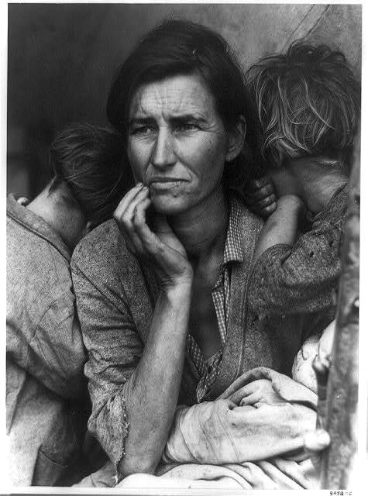
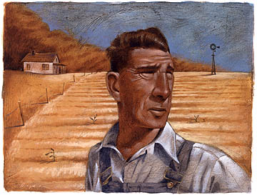
The Agricultural Crisis
Farmers began to feel an economic crisis in the early 1920s
Increased food production during World War I caused many farmers to go heavily into debt
It became difficult for many farmers to pay their debts when commodity prices declined once the World War I ended
The Dust Bowl – unprecedented drought (no rain)

Slide 11
The Dust Bowl
The Dust Bowl - farmers crops literally blown away or buried
Oklahoma, Kansas, Colorado
Poor farmers head west but find few jobs (fruit picking, low paying jobs)
Grapes of Wrath – John Steinbeck

Slide 12
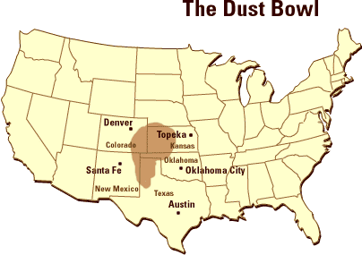

Slide 13
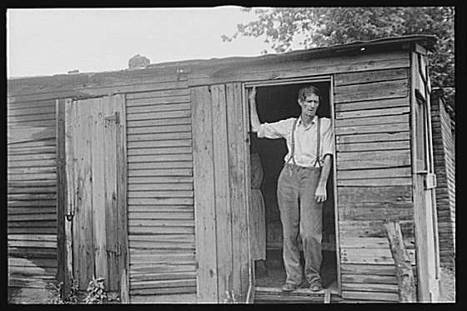

Slide 14
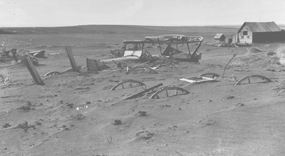

Slide 15
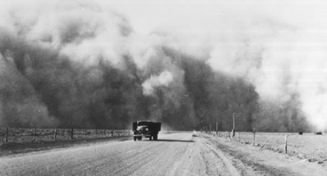

Slide 16
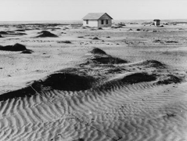

Slide 17
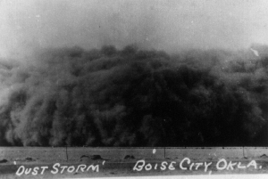

Slide 18
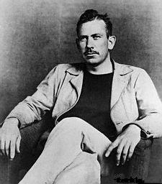
John Steinbeck
American novelist
Won the Nobel Prize for Literature in 1962
The Grapes of Wrath won the Pulitzer Prize in 1940
Described the economic realities of the Okies – migrant farmers (many from Oklahoma) who sought a new future in California’s fields

Slide 19
Life During the Depression
Women – lower pay, more working, family strain
African Americans – hardest hit, excluded from relief programs, increase in lynchings, little support from FDR
Improvements – some relief provided, support from Eleanor Roosevelt, Fair Employment Practices Committee
Mexican Americans – Discrimination in society, increase in white migrant labor, some return to Mexico

Slide 20
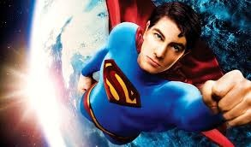
Only the Superman can save the US.

Slide 21
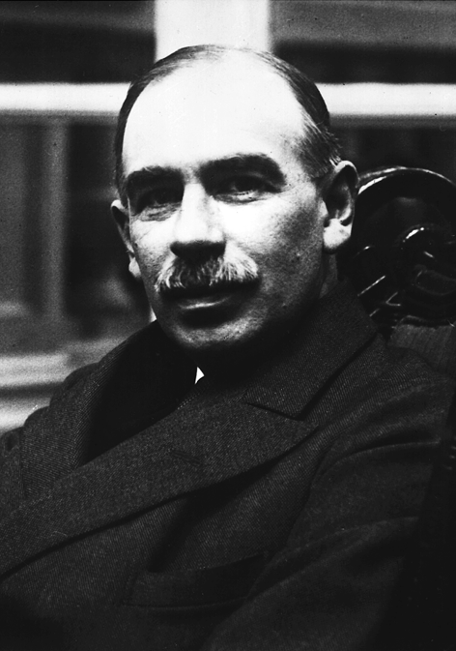
THE GREATEST ECONOMIST, EVER
John Maynard Keynes
Modern macroeconomics comes from the works of John Maynard Keynes.
He wrote the General Theory of Employment, Interest and Money.
Known as the GENERAL THEORY
It was published in 1936.

Slide 22

Practical men, who believe themselves to be quite exempt from any intellectual influences, are usually the slaves of some defunct (=useless) economist.
–John Maynard Keynes (1883-1946) in The General Theory of Employment, Interest and Money

Slide 23
How did the economy recover from the Great Depression?
The English economist John Maynard Keynes developed a solution.
He also invented macroeconomics.
Keynes:
“The Great Depression is a problem of insufficient aggregate demand”.
“If the private economy cannot generate sufficient demand, it will be the government's responsibility to do so.”

Slide 24
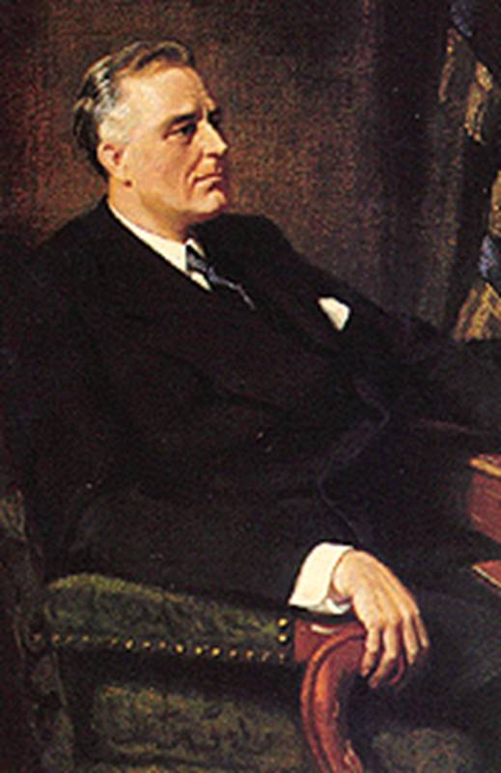
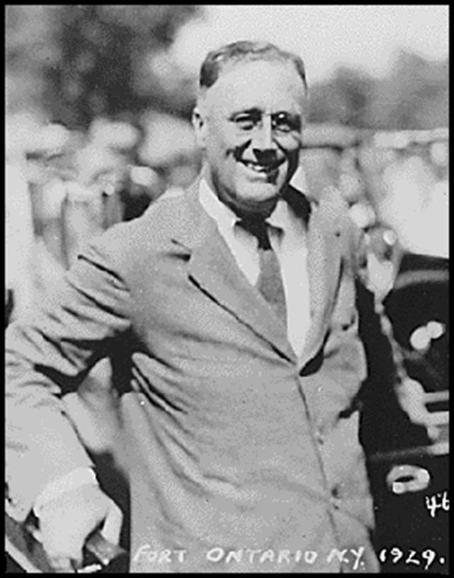
Enter Superman’s sidekick
Franklin D. Roosevelt

Slide 25
FDR & the NEW DEAL
Franklin D. Roosevelt was elected president of the US in 1932 with 60% of the popular vote.

Slide 26
FDR (President Roosevelt) and the “New Deal”
Ideas based on Keynes’s theory
large scale programs that “made jobs,”
raised commodity prices by providing farm subsidies,
reformed American economic institutions (i.e., banks, stock market, etc.)

Slide 27
RELIEF: Ease Suffering of the Needy
FERA / 1933 Federal Emergency Relief Act
Distributed $500 million of direct aid to unemployed workers such as food, clothing and grants of money to cities.

Slide 28
RELIEF: Ease Suffering of the Needy
PWA / 1933 to 1943
Public Works Administration
Employed 8.5 million workers in construction and other jobs,
Also provided work in arts, theater, and literary projects.

Slide 29
CCC / 1933 to 1942
Civilian Conservation Corps
Sent 3 million young men to work camps to build bridges, replant forests and other conservation tasks.
Develop job skills and improve environment.
Removed surplus of workers from cities, provided healthy conditions for boys, provided money for families.

Slide 30
HOLC / 1933
Home Owners Loan Corporation
Prevented mortgage foreclosures. US Govt. bought up mortgages and refinanced them so that homeowners could pay their mortgages.

Slide 31
REFORM: Prevent Another Depression
SSA / 1935 Social Security Act
It provided retirement pensions, unemployment insurance, aid to blind, deaf, disabled, and dependent children.

Slide 32
Long‑Term Effects of the Great Depression
The commitment by the government to policies that ensure full employment and economic growth.
A Social Security System that ensures income for the elderly, the infirm, and the orphaned.
The deposit insurance which guarantees people’s savings in the banking system and gives protection against bank runs.

Slide 33
Global Financial Crisis 2008-2009

Slide 34
Global Financial Crisis - 2008-09
A short story of credit crunch
http://www.youtube.com/watch?v=wGxmgwUWNr0&feature=related
A short story of financial crisis
http://www.youtube.com/watch?v=h4Ns4ltUvfw&feature=related
Financial crisis in a perspective by David Harvey, a critical Marxist thinker
http://www.youtube.com/watch?v=qOP2V_np2c0

Slide 35
Global Financial Crisis - 2008-09
Congress’s repeal of the Glass-Steagall Act (1933) in 1999, which had been introduced to prevent financial organizations from engaging in the type of financial speculation.
Wall Street has made a “quiet coup” over US govt.
Share of finance in total domestic profits: 1970s-1985, 16% or less; 2000s, 40+%
Power of finance underpinned by intense income polarization: top 1% of households = 22% income in 2006, up from 9% 1980.
Global imbalances: US-type model based on import surpluses and China-type model based on export surpluses. As a result, particularly low-income countries cannot break into international markets and run deficit.

Slide 36
Global Financial Crisis - 2008-09
The upshot was that world capitalist growth came to depend on insatiable U.S., UK, and other deficit-country demand.
The induced capital flows from surplus countries then had two effects:
they financed the deficit-country demand at low interest rates, via rising indebtedness;
they encouraged expansion of ever-more complex and risky credit instruments.

Slide 37
Global Financial Crisis - 2008-09
Two problems: currency recycling from surplus countries to deficit countries (especially from China, with its giant dollar surplus, to the United States, with its giant deficit) and credit recycling in the United States and the UK, as households and firms took on the debt corresponding to the external deficit, raising debt-to-income ratios to historically high levels.
As it happened, the crisis in the United States and the UK erupted in the credit-recycling part of the process rather than in the currency recycling part (which is where some analysts thought it would break out, in the form of a tsunami out of the dollar). It then spread quickly elsewhere through long chains of credit-debt relations.

Slide 38
Global Financial Crisis - 2008-09
Income inequality: The US is the most unequal. During Reagan\Teatcher period, the great compression of the golden age (60’s until the beginning of 70’s) is reversed. This period is the biggest upward redistribution in the West.

Slide 39
US: income share of top 1%, 1913--2006

Slide 40
US: income of top 1%, middle 60%, bottom 20%, 1980 - 2005

Slide 41
US: wealth, gains
Top 1%
owns more than a third of the nation’s wealth.
received more than 65% of the gain in total national income during 2002-2007.
received 93% of the additional income created in 2010, compared to 2009.
received only 12% of the nation’s income thirty years ago.
Walton family: the six heirs to the Wal-Mart command wealth of $70 billion, which is equivalent to the wealth of the entire bottom 30% of US society.

Slide 42
What is this Gross Domestic Product (GDP)?
It means “Gayri Safi Yurtiçi Hasıla” (GSYH)
GDP is the market value of all final goods & services produced in a country in a given period of time.
GDP also equals the total income of everyone in the economy.
For the economy as a whole, income equals expenditure, because every lira (euro, dollar, yen) of expenditure by a buyer is a lira (euro, dollar, yen) of income for the seller.

Slide 43
Trickle-down?
The fraction of those in poverty was 15% in 2010.
The number of American families in extreme poverty-living on 2$ a day per person or less- had doubled since 1996, to 1.5 million.

Slide 44
Other indicators
Infant and maternal mortality: the US is little better than in some developing countries. (infant mortality: worse than Cuba, Belarus, Malaysia.)
Some 19% of men btw 25-34 are living with their parents.
The US incarceration rate of 730 per 100,000 people (or almost 1 in 100 adults) is the world’s highest and 10 times that of many European countries.

Slide 45
Other indicators
Education, unemployment: later

Slide 46
Global Financial Crisis - 2008-09
Global Economic Crisis (GEC) is superficially a debt crisis, fundamentally a wages crisis, reflecting global imbalances & breakdown in link from productivity growth to wages growth. Tendency to underconsumption.
Proposition
(i) Wages growth in line with productivity growth brings macrostability.
(ii) Wages growth below productivity growth brings underconsumption (insufficient aggregate demand), overaccumulation crises, which can be postponed by exports or borrowing.
This last point explains the tip of the iceberg: insufficient aggregate demand blows the housing market.
“How could prices continue to grow, especially for housing for lower and middle-income individuals, as incomes stagnated?”
Joseph Stiglitz (2009)

Slide 47
Real wages in the US
Real wages in the US rose during every decade from 1830 to 1970 but started to decline afterwards.
Source: Labor Research Associates of New York based on data from the US Department of Labor, Bureau of Labor Statistics; wages expressed in constant 1982 dollars.
Year | Weekly real wage (US $)
1964 | 302.52
1974 | 314.94
1984 | 279.22
1994 | 259.97
2004 | 277.57

Slide 48
Global Financial Crisis - 2008-09
Wage crisis leads a tendency to underconsumption.
However, the tendency toward underconsumption was countervailed in many developed countries (notably the United States and the UK) and in some emerging market countries by the domestic and international financial system’s enabling a big expansion of credit— helping companies to invest in response to the asset boom and helping households to consume more even out of stagnant incomes.

Slide 49
Global Financial Crisis - 2008-09
In other words, after the abandonment of Keynesian policies in the 1970s and the ascendancy of neoliberal policies under Reagan and Thatcher, credit, debt, and essentially speculative investment became key to stimulate aggregate demand. The current crisis has disrupted this basic—but inherently fragile and limited—mechanism for sustaining aggregate demand.

Slide 50
Lesson for economic theory: Dead-Parrot
“The models that have predominated within macro-economics, which assume representative agents with rational expectations, are particularly disturbing. What I find even more striking is that some economists still argue that this crisis has not shaken their belief in rational expectations. To me, the evidence of irrationality, and intellectual inconsistency, abounds.
To give an example: Markets believed that real estate prices could continue to go up –a necessary belief for the toxic mortgages not to blow up- and yet the real incomes of most Americans were decreasing.”
Joseph Stiglitz, Presidential Address, The current economic crisis and lessons for economic theory, Eastern Economic Journal (2009)

Slide 51
End of the lecture

